Slide 1
Presentation On:
“ ML BASED ROAD LANE LINE DETECTION.”
Presented By:
Ms. Rutuja Tanaji Nalage . Roll No:351
Ms. Monali Dattatray Zanzane. Roll No:372
Ms. Rutuja Shrikant Jagtap. Roll No: 328
Guided By:
Prof S.S. Nimbalkar
Department of Computer Engineering

Slide 2
Introduction
LANE LINE DETECTION IS A critical component for self driving cars and also for computer vision in general . This concept is used to describe the path for self driving cars and to avoid the risk of getting in another lane
In this article, we will build a machine learning project to detect lane lines in real time .we will do this using the concepts of computer vision using open CV library .To detect the lane we have to detect the white marketing on both sides on the lane
Using computer vision technique in python ,we will identify road lane lines in which autonomous cars must runs . This will be a critical part of autonomous cars, as the self driving cars should not cross its lane and should not go in opposite lane to avoid accident

Slide 3
Problem Statement
Detected line segments are not usually collinear . Left: Line segment s detected in an image using LSD ( magenta lines) .
Right : detected segments are not strictly aligned with straight scene lines ( green lines ) .
The smallest bounding box containing the segments of a scene line is plotted in yellow.

Slide 4
Objective:
The aim of this thesis is to avoid accidental deaths and provide a better safety on
roads, by use of advanced technologies in driving assistances system.

Slide 5
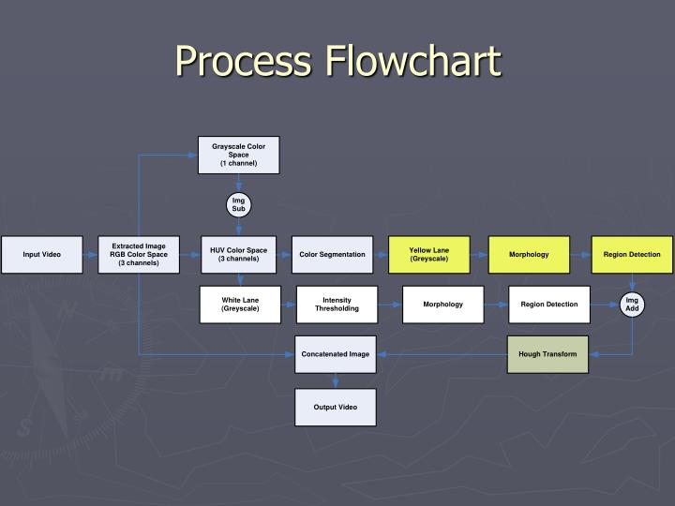

Slide 6
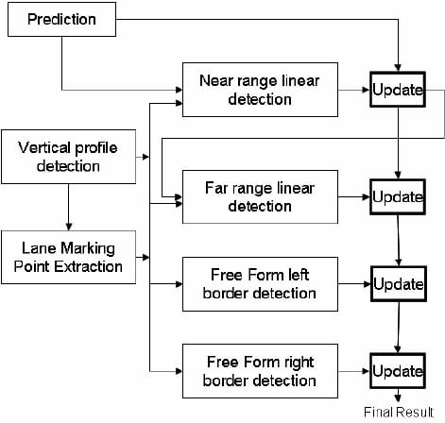
System Architecture:

Slide 7
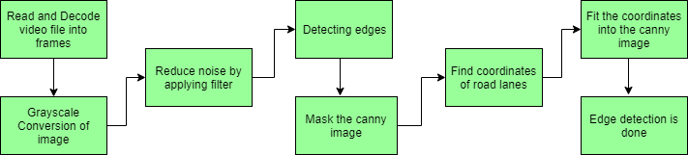
Lane Detection Involves The Following Steps:

Slide 8
Advantages:
For KeepTrackin purposes
lane detection is critical in identifying and ensuring safe driving practices.
An on-board system with this capability can alert the driver in the event of an unsafe lane change.
Lane detection is also instrumental in understanding road layout and surrounding scene geometry for proper route planning.

Slide 9
ACKNOWLEGMENT:
In this lane line detection project, we use OpenCV. Before detecting lane lines, we masked remaining objects and then identified the line with Hough transformation.

Slide 10
CONCLUSION:
The project was successful in that the video images clearly show the lane lines are detected properly and lines are very smoothly handled.
It only detects the straight lane lines. It is an advanced topic to handle curved lanes (or the curvature of lanes). We’ll need to use perspective transformation and also poly fitting lane lines rather than fitting to straight lines.
Having said that, the lanes near the car are mostly straight in the images. The curvature appears at further distance unless it’s a steep curve. So, this basic lane finding technique is still very useful.
Another thing is that it won’t work for steep (up or down) roads because the region of interest mask is assumed from the center of the image.
For steep roads, we first need to detect the horizontal line (between the sky and the earth) so that we can tell up to where the lines should extend.

Slide 11
REFERENCE:
Benozzi, M. and A. Broggi, M. Cellario, 2002. Artificial vision in road vehicles. Proceedings of IEEE,90 (7): 1258-1271.Broggi, B.M., 1998. GOLD: A parallel real-time stereo Vision system for generic obstacle and lanedetection, IEEE Transactions on Image Processing, 1998: 4-6.Chen., M., T. Jochem D.T. Pomerleau, 2004. AURORA: A Vision- Based Roadway Departure Warning System, In Proceeding of IEEE Conference on Intelligent Robots and Systems.Chen, Q., H. Wang, 2006. A Real-Time Lane Detection Algorithm Based on a Hyperbola-Pair, Proceedingsof IV2006,. IEEE Intelligent Vehicles Symposium, pp: 1-6.G…

Slide 12
THANK YOU !!!!!!!!!!!!!!!!!

